Slide 1

Chapter 2
Mathematics of Cryptography
Part I: Modular Arithmetic, Congruence,
and Matrices
2.<number>
Copyright © The McGraw-Hill Companies, Inc. Permission required for reproduction or display.

Slide 2
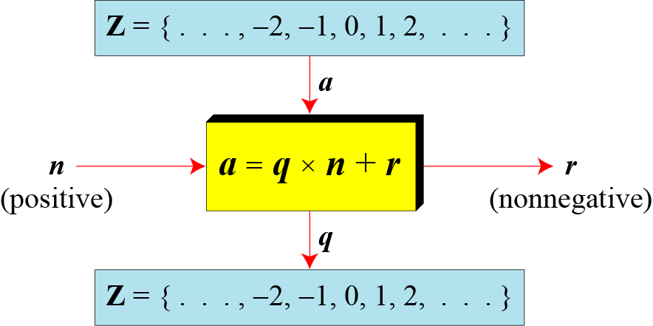
Divisibility in numbers
Division algorithm for integers
2.<number>

Slide 3

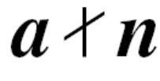
Divisbility
If a is not zero and we let r = 0 in the division relation, we get
a = q × n
If the remainder is zero,
If the remainder is not zero,
2.<number>

Slide 4

Note
Fact 1: The integer 1 has only one
divisor, itself.
Fact 2: Any positive integer has at least
two divisors, 1 and itself (but it
can have more).
2.<number>

Slide 5
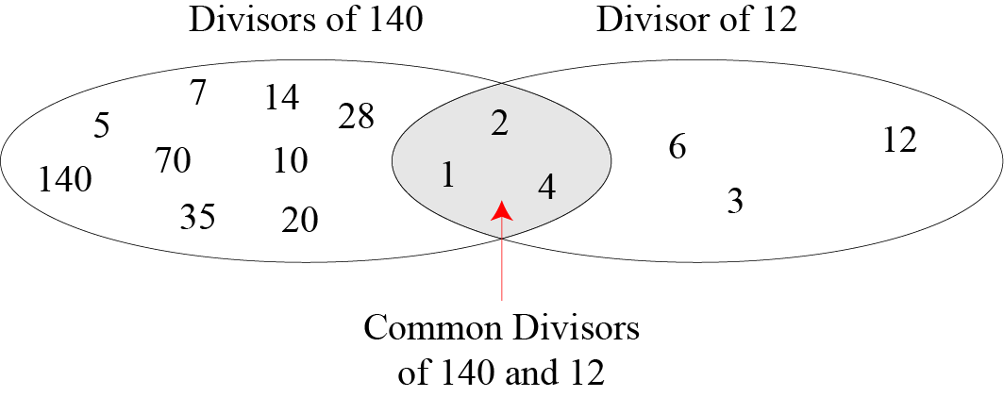
Figure 2.6 Common divisors of two integers
2.<number>

Slide 6
Note
Greatest Common Divisor
The greatest common divisor of two positive integers is the largest integer that can divide both integers.
Note
Euclidean Algorithm
Fact 1: gcd (a, 0) = a
Fact 2: gcd (a, b) = gcd (b, r), where r is
the remainder of dividing a by b
2.<number>

Slide 7
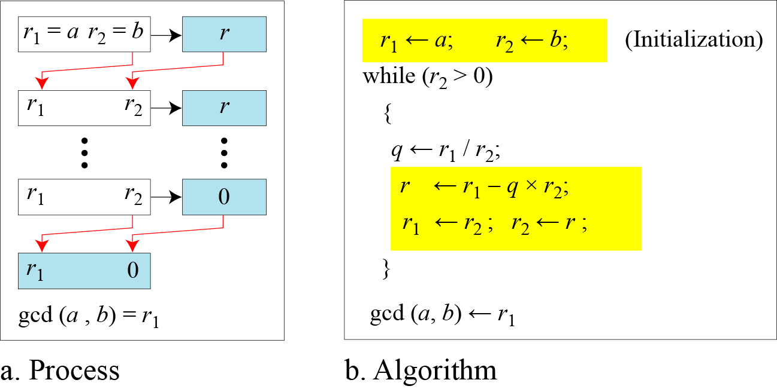
Figure 2.7 Euclidean Algorithm
Note
When gcd (a, b) = 1, we say that a and b are relatively prime.
2.<number>

Slide 8
Note
When gcd (a, b) = 1, we say that a and b are relatively prime.
2.<number>

Slide 9
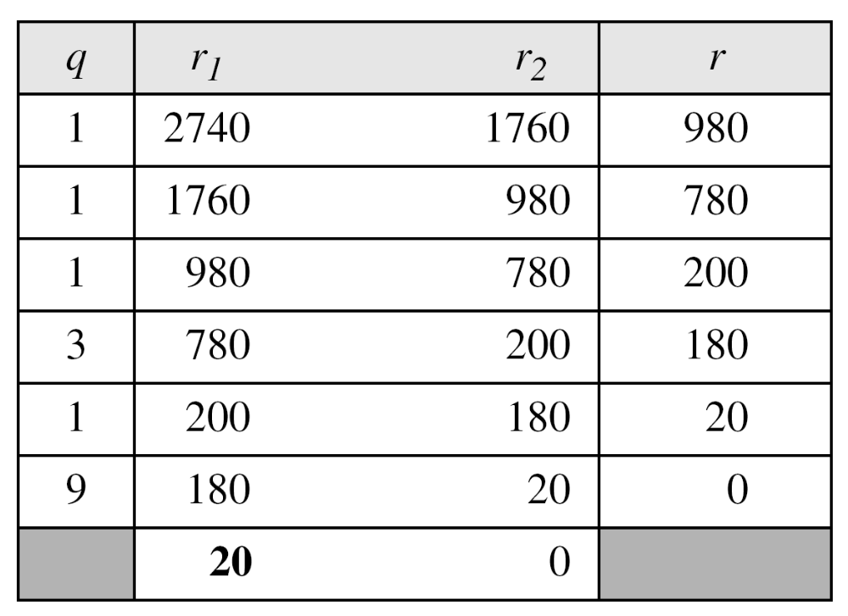
Example 2.7
Find the greatest common divisor of 2740 and 1760.
Solution
We have gcd (2740, 1760) = 20.
2.<number>

Slide 10
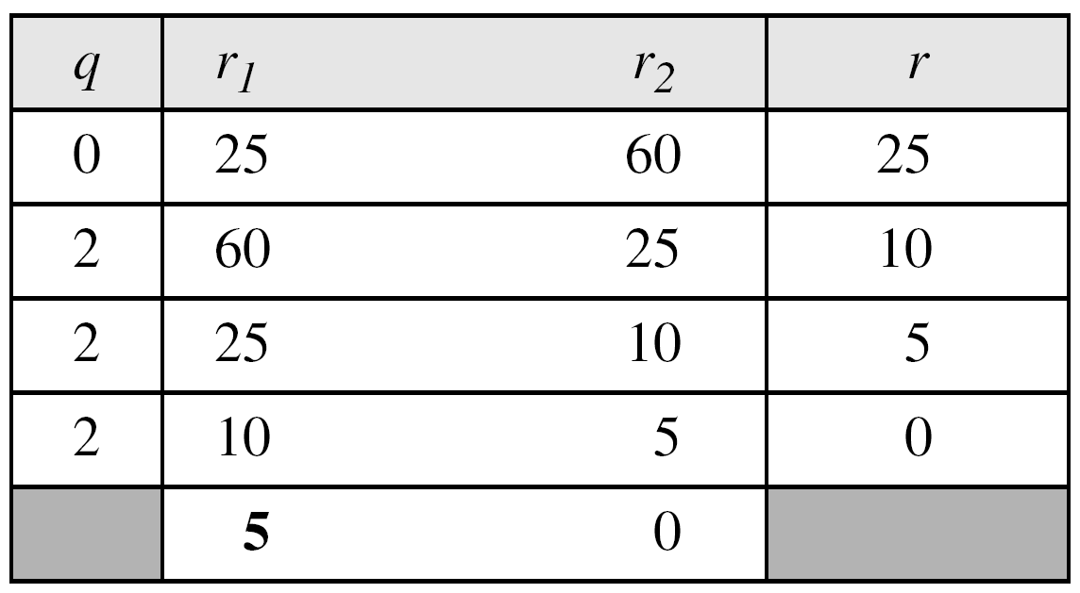
Example 2.8
Find the greatest common divisor of 25 and 60.
Solution
We have gcd (25, 65) = 5.
2.<number>

Slide 11

Extended Euclidean Algorithm
Given two integers a and b, we often need to find other two integers, s and t, such that
The extended Euclidean algorithm can calculate the gcd (a, b) and at the same time calculate the value of s and t.
2.<number>

Slide 12
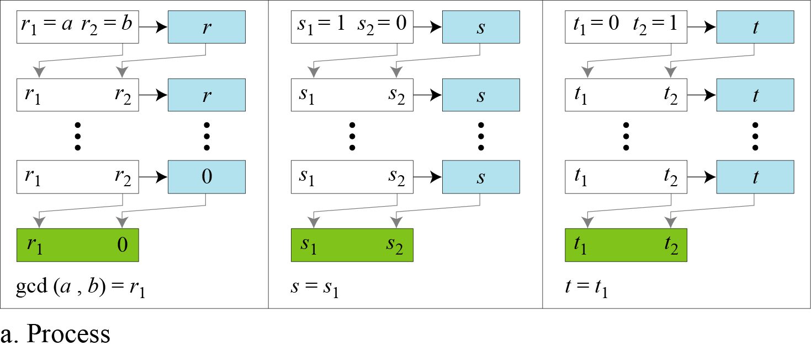
Figure 2.8.a Extended Euclidean algorithm, part a
2.<number>

Slide 13
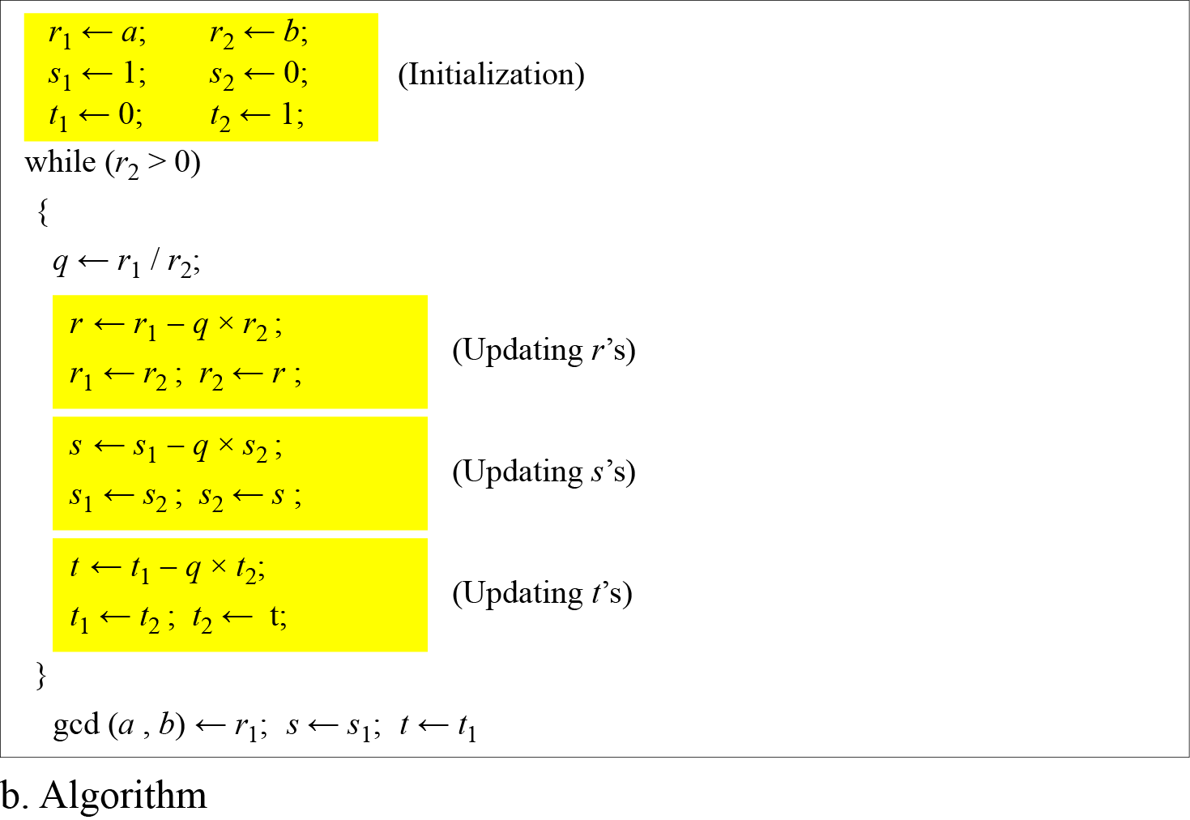
Figure 2.8.b Extended Euclidean algorithm, part b
2.<number>

Slide 14
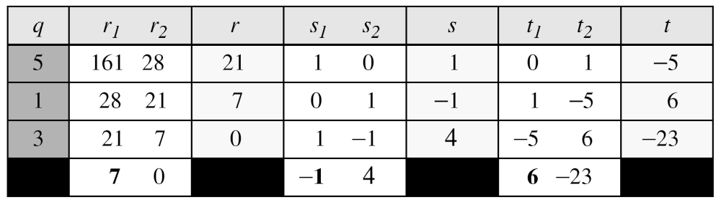
Example 2.9
Given a = 161 and b = 28, find gcd (a, b) and the values of s and t.
Solution
We get gcd (161, 28) = 7, s = −1 and t = 6.
2.<number>

Slide 15
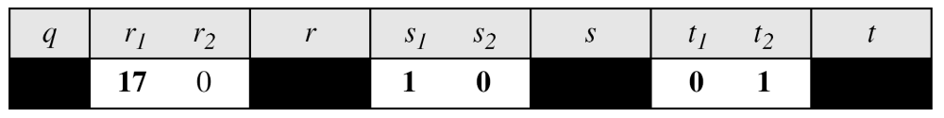
Example 2.10
Given a = 17 and b = 0, find gcd (a, b) and the values of s
and t.
Solution
We get gcd (17, 0) = 17, s = 1, and t = 0.
2.<number>

Slide 16
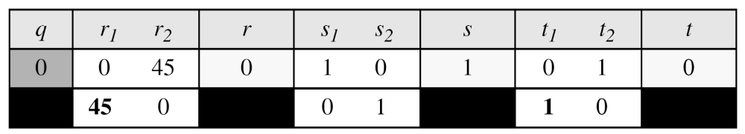
Example 2.11
Given a = 0 and b = 45, find gcd (a, b) and the values of s
and t.
Solution
We get gcd (0, 45) = 45, s = 0, and t = 1.
2.<number>

Slide 17
2-2 MODULAR ARITHMETIC
The division relationship (a = q × n + r) discussed in the previous section has two inputs (a and n) and two outputs (q and r). In modular arithmetic, we are interested in only one of the outputs, the remainder r.
Topics discussed in this section:
2.2.1 Modular Operator
2.2.2 Set of Residues
2.2.3 Congruence
2.2.4 Operations in Z_{n}
2.2.5 Addition and Multiplication Tables
2.2.6 Different Sets
2.<number>

Slide 18
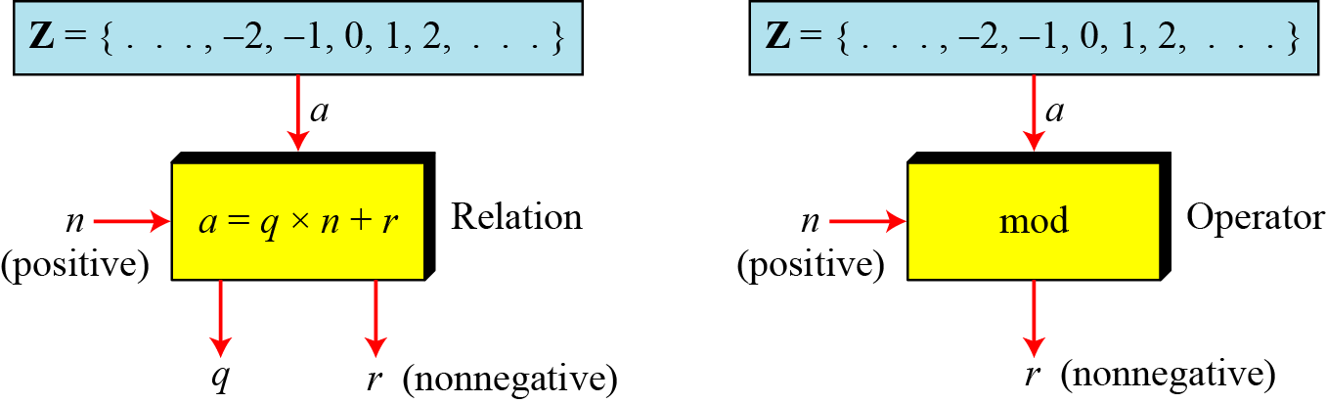
2.2.1 Modulo Operator
The modulo operator is shown as mod. The second input (n) is called the modulus. The output r is called the residue.
Figure 2.9 Division algorithm and modulo operator
2.<number>

Slide 19
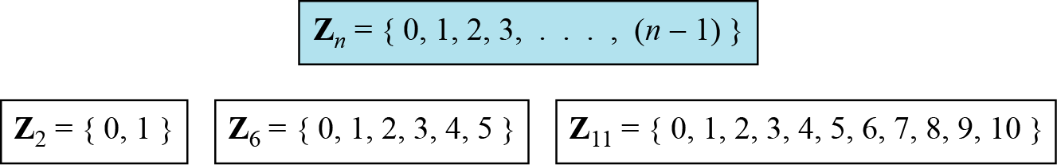
2.2.2 Set of Residues
The modulo operation creates a set, which in modular arithmetic is referred to as the set of least residues modulo n, or Z_{n}.
Figure 2.10 Some Z_{n} sets
2.<number>

Slide 20
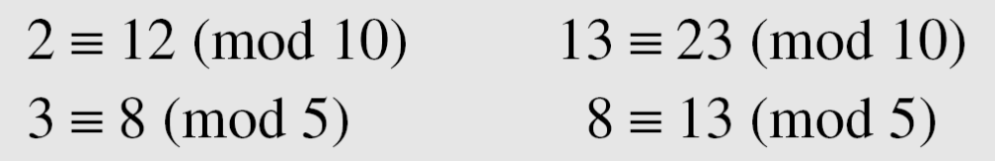
2.2.3 Congruence
To show that two integers are congruent, we use the congruence operator ( ≡ ). For example, we write:
2.<number>

Slide 21
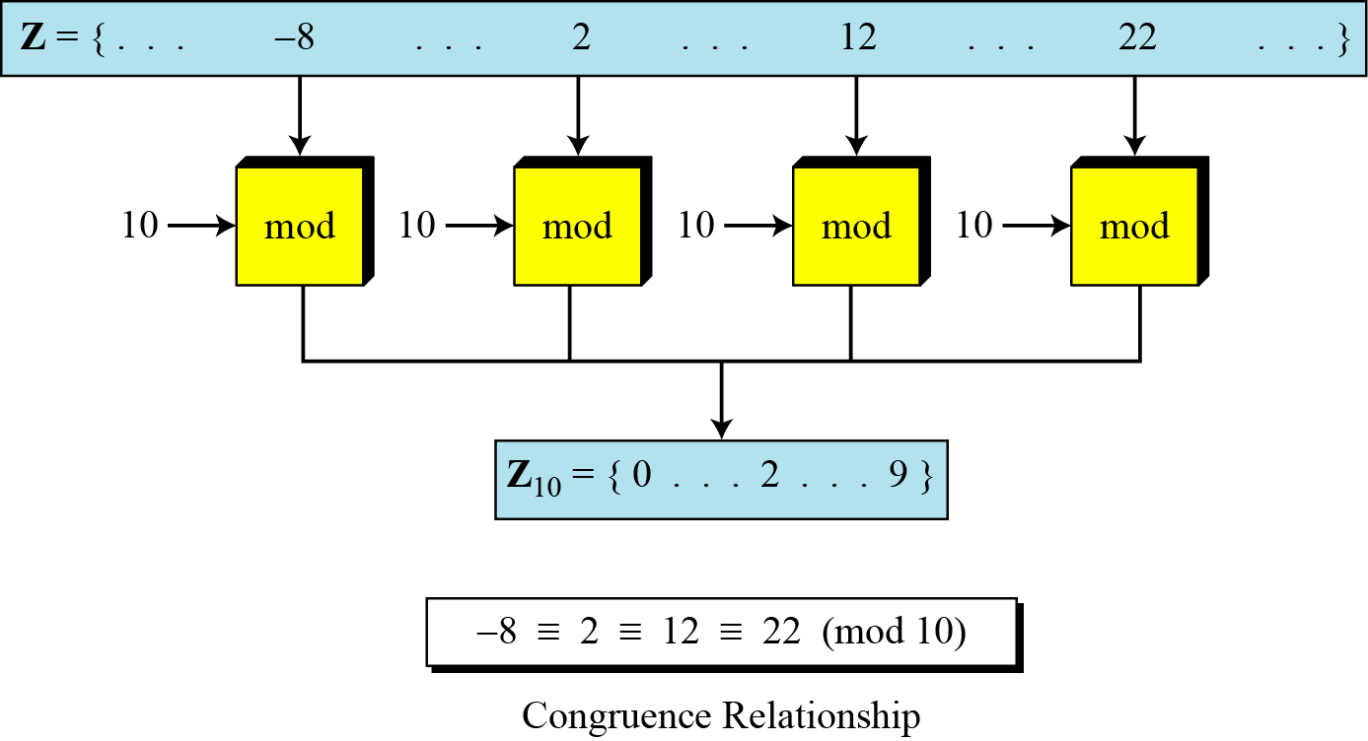
2.2.3 Continued
Figure 2.11 Concept of congruence
2.<number>

Slide 22
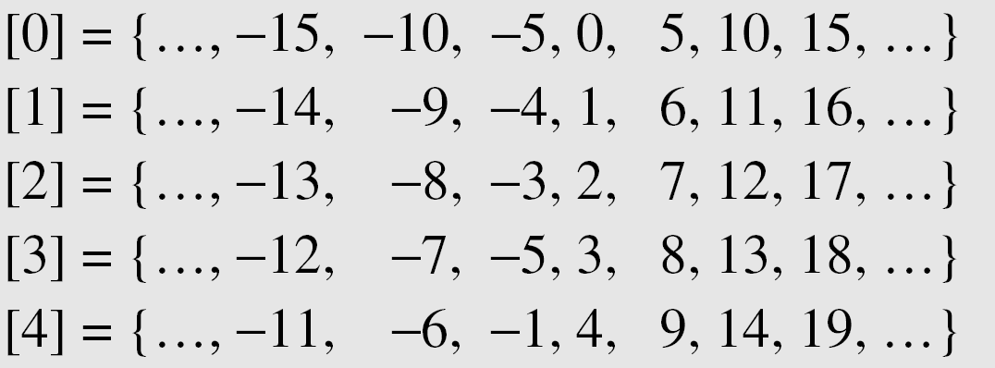
2.2.3 Continued
Residue Classes
A residue class [a] or [a]_{n} is the set of integers congruent modulo n.
2.<number>

Slide 23
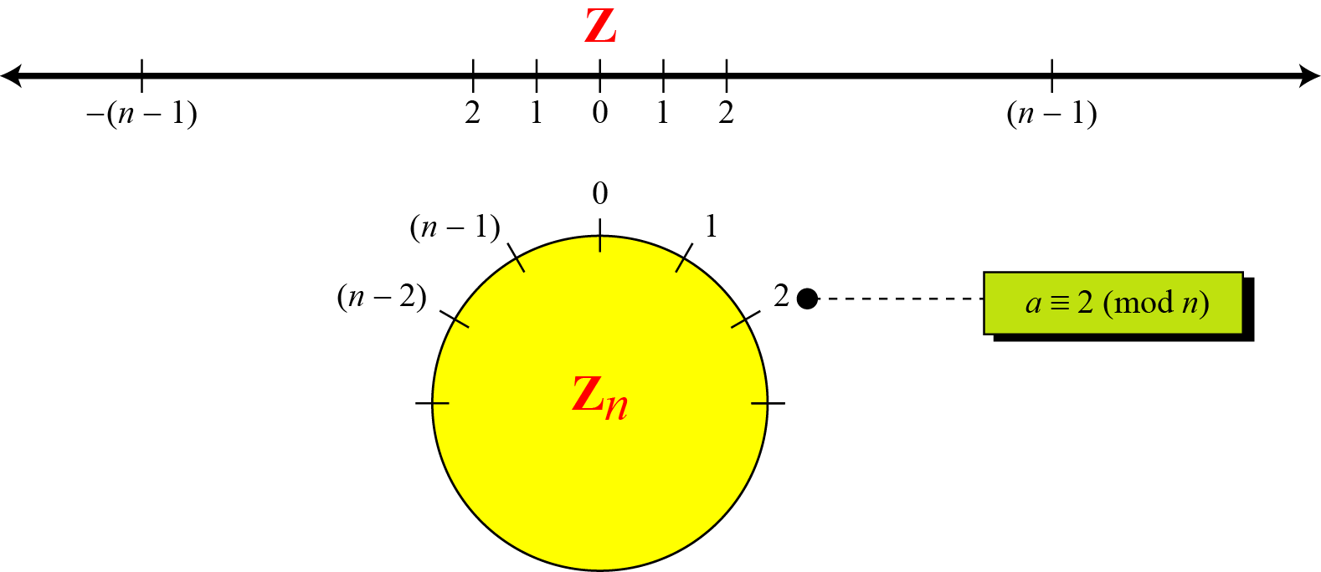
2.2.3 Continued
Figure 2.12 Comparison of Z and Z_{n} using graphs
2.<number>

Slide 24
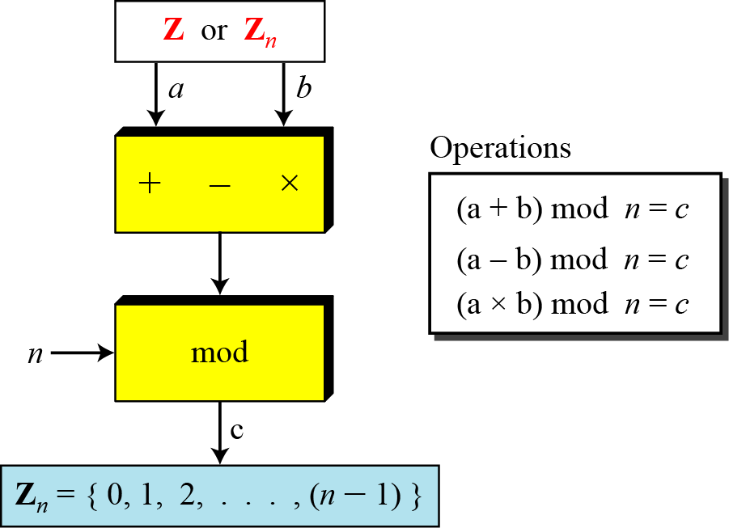
2.2.4 Operation in Z_{n}
The three binary operations that we discussed for the set Z can also be defined for the set Zn. The result may need to be mapped to Zn using the mod operator.
Figure 2.13 Binary operations in Z_{n}
2.<number>

Slide 25
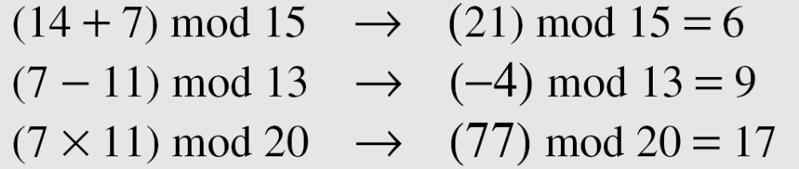
2.2.4 Continued
Example 2.16
Perform the following operations (the inputs come from Zn):
a. Add 7 to 14 in Z15.
b. Subtract 11 from 7 in Z13.
c. Multiply 11 by 7 in Z20.
Solution
2.<number>

Slide 26
2.2.4 Continued
Example 2.17
Perform the following operations (the inputs come from either Z or Z_{n}):
a. Add 17 to 27 in Z₁₄.
b. Subtract 43 from 12 in Z₁₃.
c. Multiply 123 by −10 in Z₁₉.
Solution
2.<number>

Slide 27
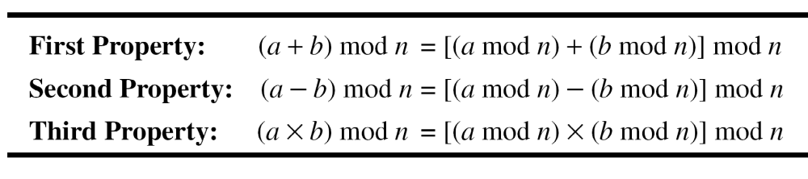
2.2.4 Continued
Properties
2.<number>

Slide 28
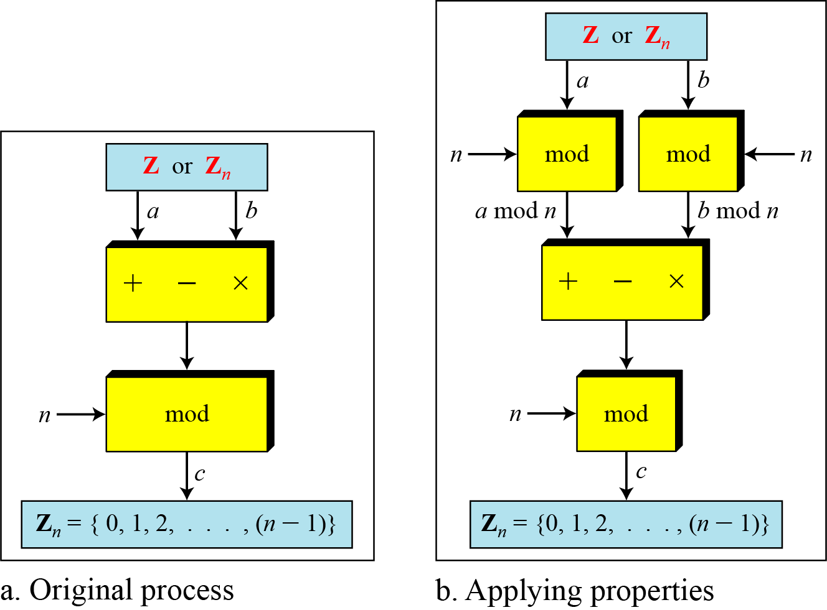
2.2.4 Continued
Figure 2.14 Properties of mode operator
2.<number>

Slide 29
2.2.4 Continued
Example 2.18
The following shows the application of the above properties:
1. (1,723,345 + 2,124,945) mod 11 = (8 + 9) mod 11 = 6
2. (1,723,345 − 2,124,945) mod 16 = (8 − 9) mod 11 = 10
3. (1,723,345 × 2,124,945) mod 16 = (8 × 9) mod 11 = 6
2.<number>

Slide 30
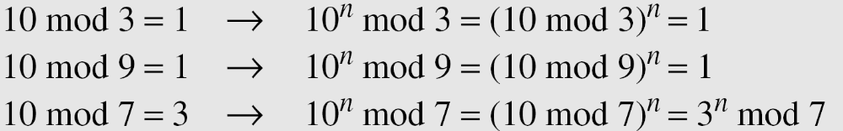
2.2.4 Continued
Example 2.19
In arithmetic, we often need to find the remainder of powers of 10 when divided by an integer.
2.<number>

Slide 31
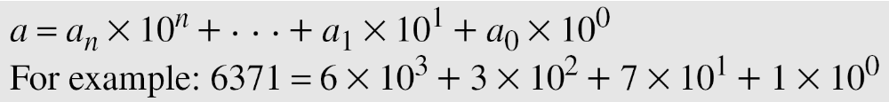
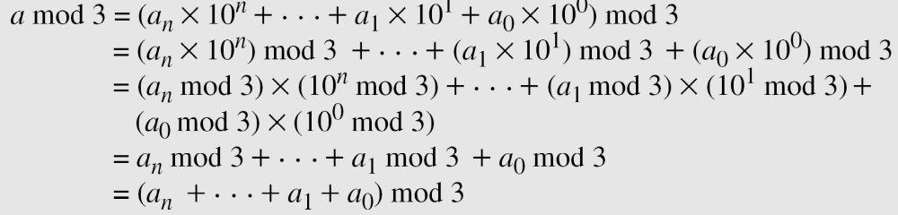
2.2.4 Continued
Example 2.20
We have been told in arithmetic that the remainder of an integer divided by 3 is the same as the remainder of the sum of its decimal digits. We write an integer as the sum of its digits multiplied by the powers of 10.
2.<number>

Slide 32
2.2.5 Inverses
When we are working in modular arithmetic, we often need to find the inverse of a number relative to an operation. We are normally looking for an additive inverse (relative to an addition operation) or a multiplicative inverse (relative to a multiplication operation).
2.<number>

Slide 33

2.2.5 Continue
Additive Inverse
In Z_{n}, two numbers a and b are additive inverses of each other if
Note
In modular arithmetic, each integer has an additive inverse. The sum of an integer and its additive inverse is congruent to 0 modulo n.
2.<number>

Slide 34
2.2.5 Continued
Example 2.21
Find all additive inverse pairs in Z10.
Solution
The six pairs of additive inverses are (0, 0), (1, 9), (2, 8), (3, 7), (4, 6), and (5, 5).
2.<number>

Slide 35

2.2.5 Continue
Multiplicative Inverse
In Z_{n}, two numbers a and b are the multiplicative inverse of each other if
Note
In modular arithmetic, an integer may or may not have a multiplicative inverse.
When it does, the product of the integer and its multiplicative inverse is congruent to 1 modulo n.
2.<number>

Slide 36
2.2.5 Continued
Example 2.22
Find the multiplicative inverse of 8 in Z₁₀.
Solution
There is no multiplicative inverse because gcd (10, 8) = 2 ≠ 1. In other words, we cannot find any number between 0 and 9 such that when multiplied by 8, the result is congruent to 1.
Example 2.23
Find all multiplicative inverses in Z₁₀.
Solution
There are only three pairs: (1, 1), (3, 7) and (9, 9). The numbers 0, 2, 4, 5, 6, and 8 do not have a multiplicative inverse.
2.<number>

Slide 37
2.2.5 Continued
Example 2.24
Find all multiplicative inverse pairs in Z₁₁.
Solution
We have seven pairs: (1, 1), (2, 6), (3, 4), (5, 9), (7, 8), (9, 9), and (10, 10).
We have six pairs: (1, 1), (2, 6), (3, 4), (5, 9), (7, 8), and (10, 10).
2.<number>

Slide 38
2.2.5 Continued
Note
The extended Euclidean algorithm finds the multiplicative inverses of b in Z_{n} when n and b are given and
gcd (n, b) = 1.
The multiplicative inverse of b is the value of t after being mapped to Z_{n}.
2.<number>

Slide 39
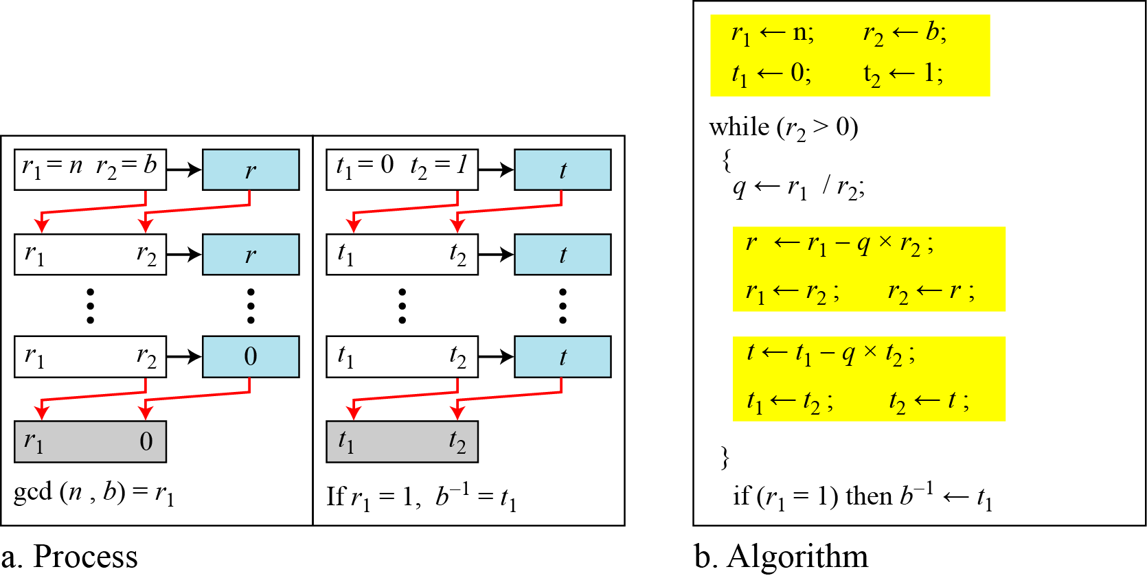
2.2.5 Continued
Figure 2.15 Using extended Euclidean algorithm to
find multiplicative inverse
2.<number>

Slide 40
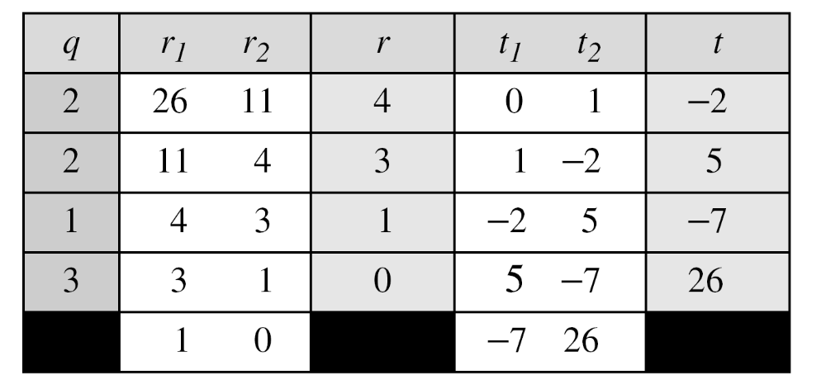
2.2.5 Continued
Example 2.25
Find the multiplicative inverse of 11 in Z₂₆.
Solution
The gcd (26, 11) is 1; the inverse of 11 is −7 or 19.
2.<number>

Slide 41
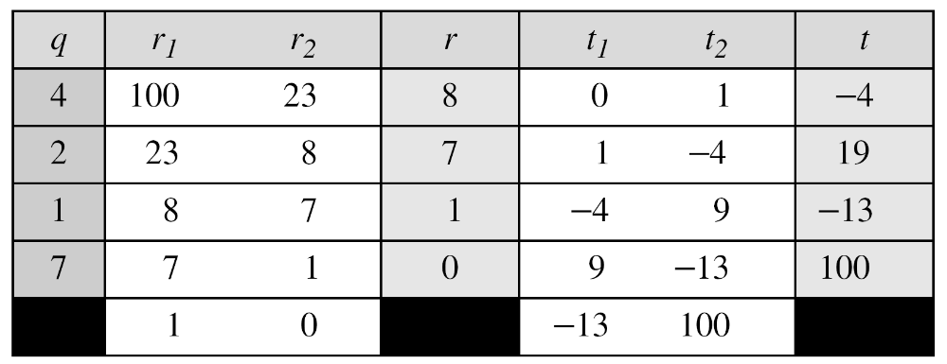
2.2.5 Continued
Example 2.26
Find the multiplicative inverse of 23 in Z₁₀₀.
Solution
The gcd (100, 23) is 1; the inverse of 23 is −13 or 87.
2.<number>

Slide 42
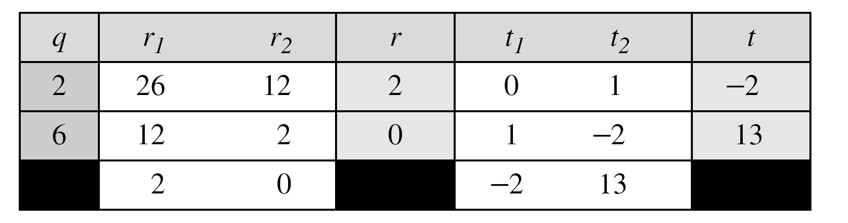
2.2.5 Continued
Example 2.27
Find the inverse of 12 in Z₂₆.
Solution
The gcd (26, 12) is 2; the inverse does not exist.
2.<number>

Slide 43
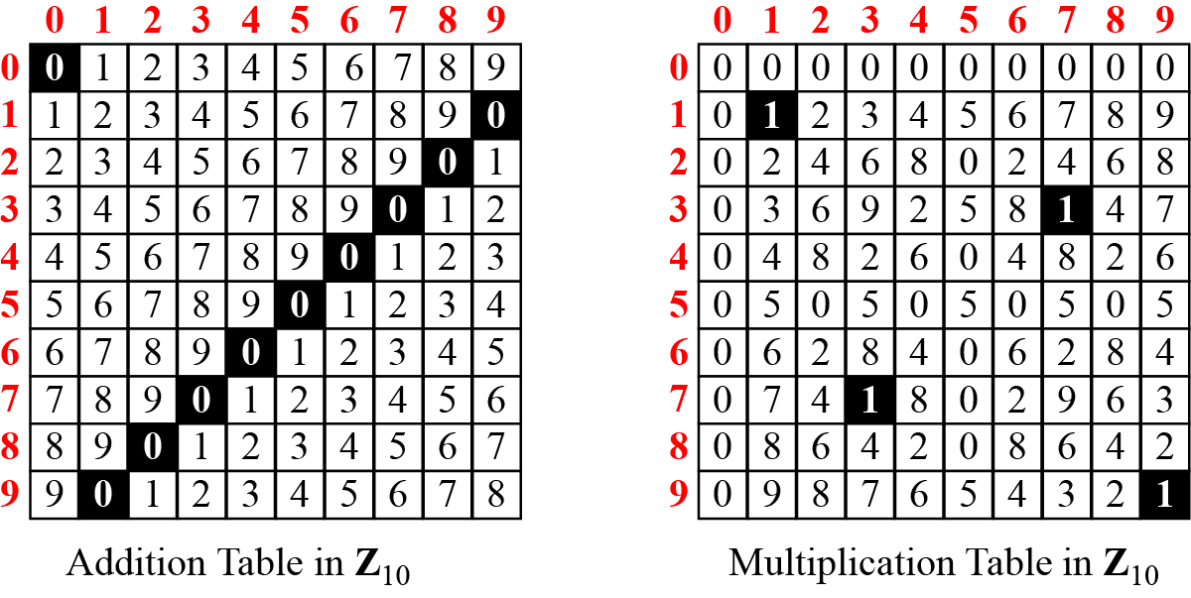
2.2.6 Addition and Multiplication Tables
Figure 2.16 Addition and multiplication table for Z₁₀
2.<number>

Slide 44
2.<number>

